Slide 1
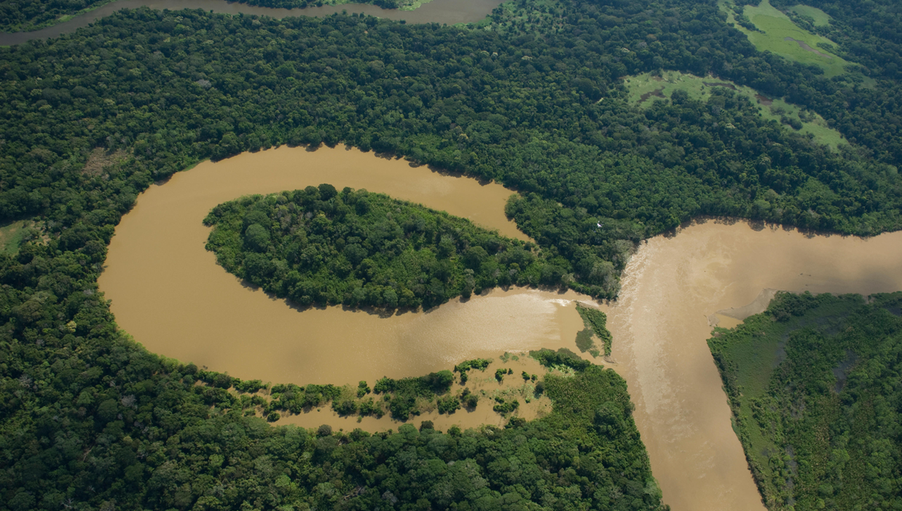

How will the migration affect the creation of oxbow lakes?
Ye Jing
Earth Surface Process EAS-G 559
Instructor: Doug Edmonds
Notes:
HI my name is Ye from Indiana university, I am excited to share our recent work with you about what controls the creation of oxbow lakes. As we can see here, oxbow lakes, are water bodies on the floodplains disconnected with river channels.

Slide 2
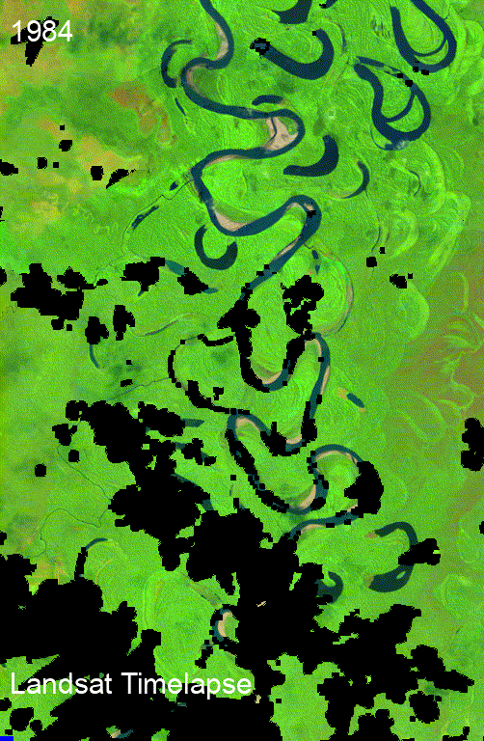
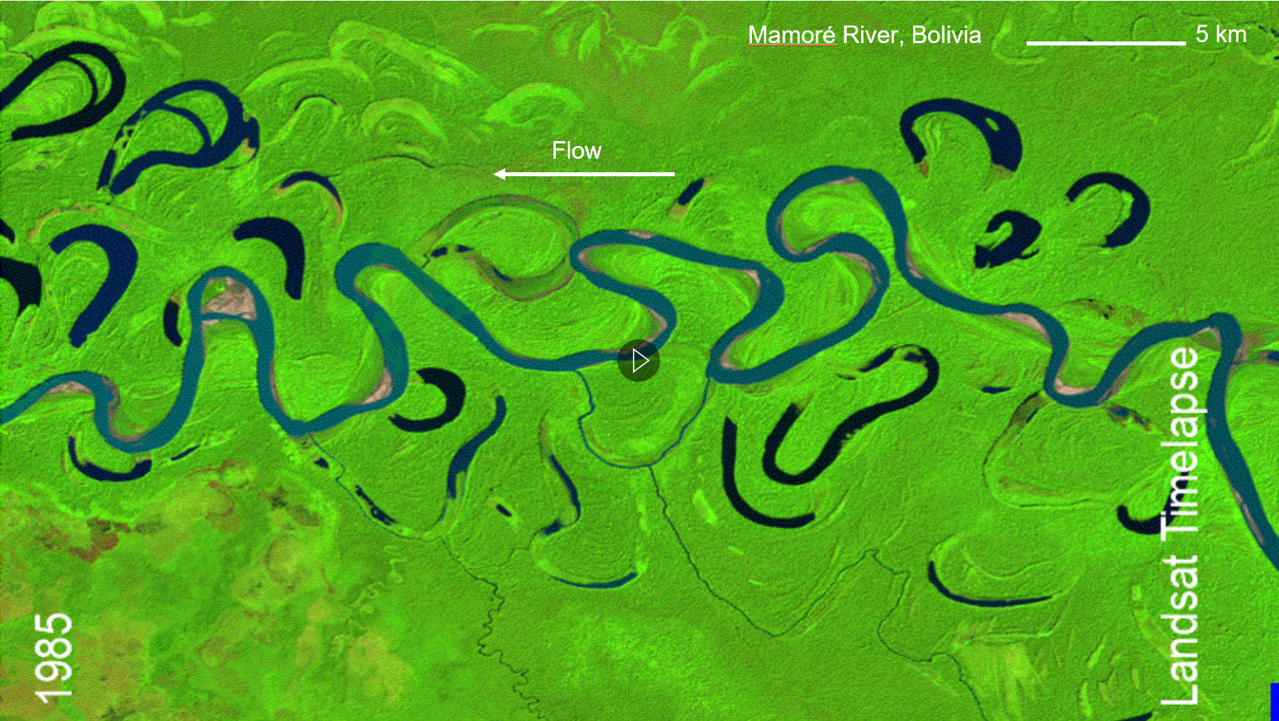
Neck Cutoff
Chute Cutoff
Flow
How will migration contribute to the creation of oxbow lakes?
Mamoré River, Bolivia
2
5 km
Notes:
Oxbow lakes are one of the most common features in meandering rivers, as can be seen in this example in Mamore river in Bolivia. Oxbow lakes are critical for environment and ecology. They serve as habitats for many species and as effective sinks for fine sediment and associated pollutants. Oxbow lakes are formed when the meandering river cuts off. In this video (click) this neck cutoff (click) leads to a long persistent oxbow lake, while this chute cutoff (click) leads to an oxbow lake which is filled very quickly. The research question I want to focus is: How is a persistent oxbow lake created?

Slide 3
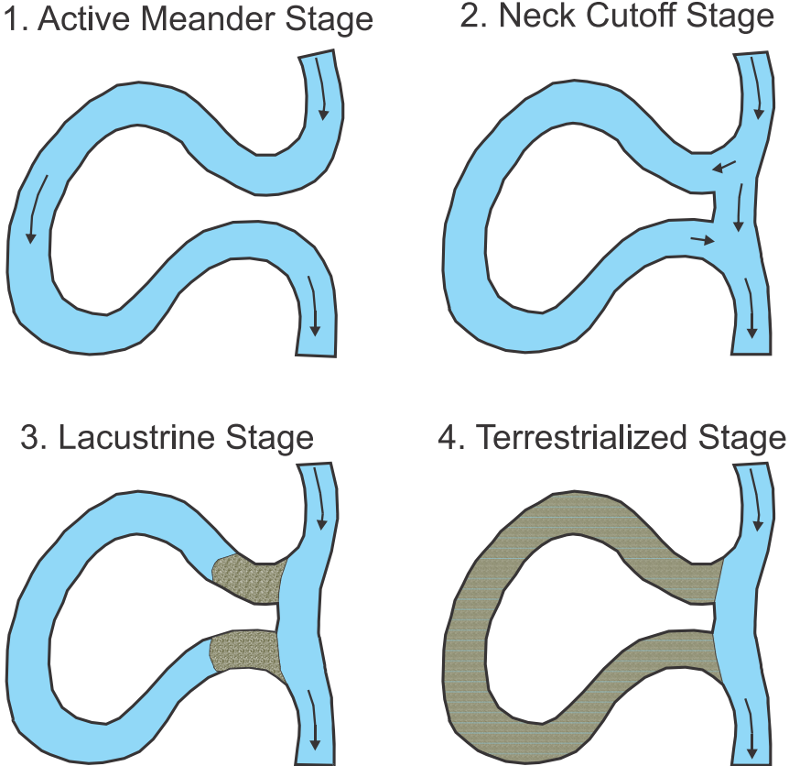
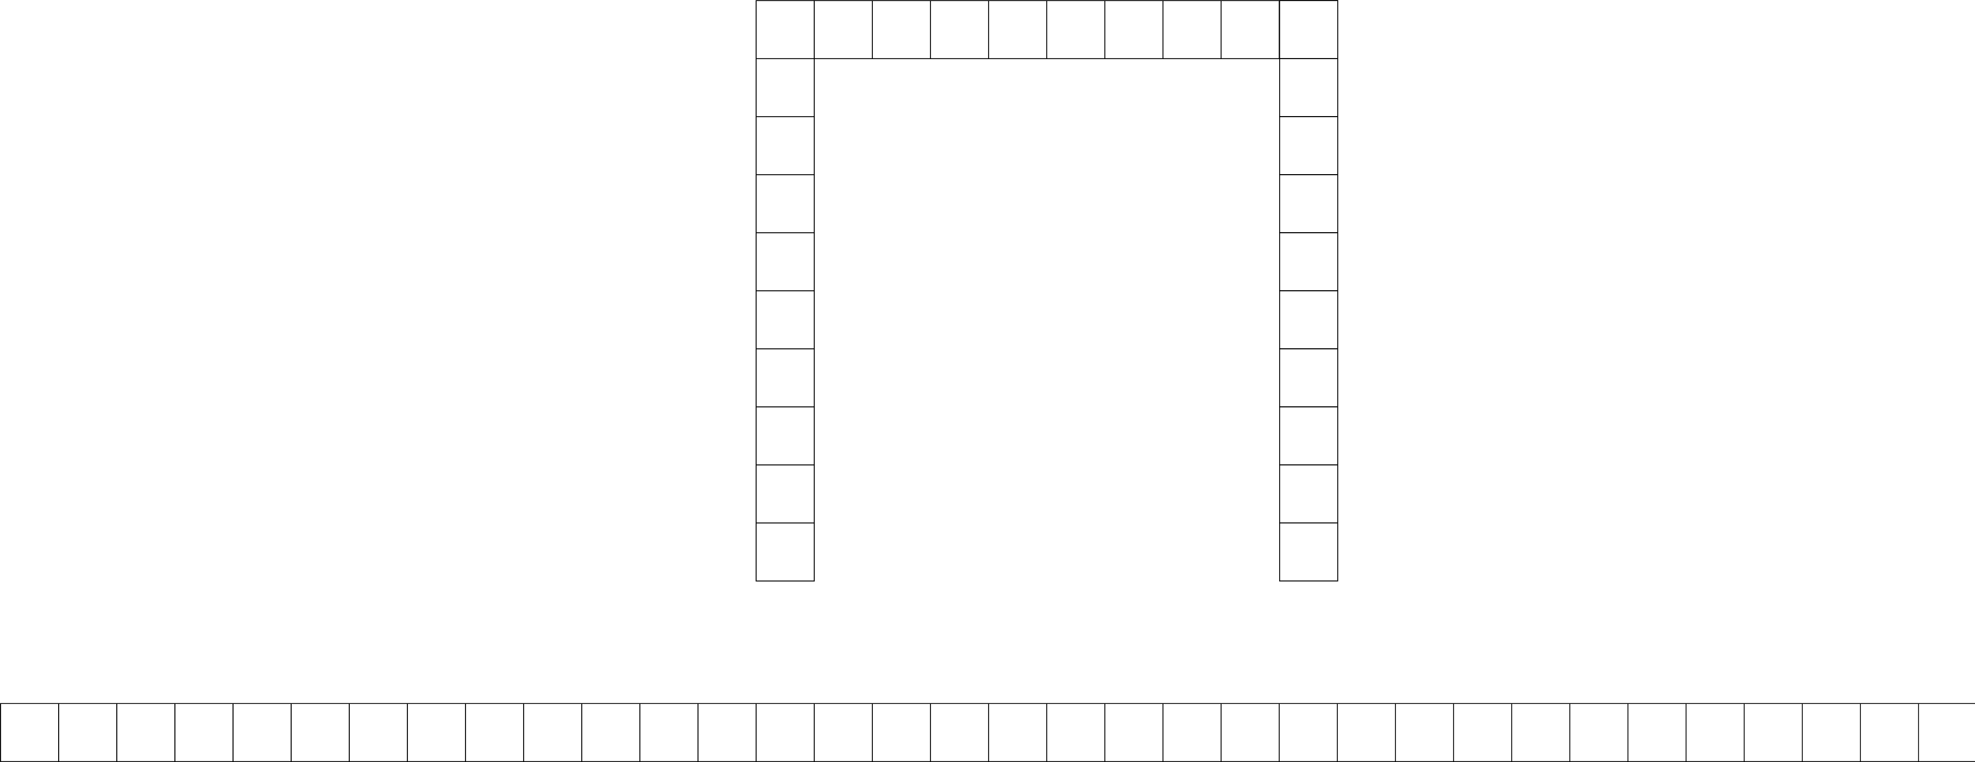
Previous research has focused on bifurcation
Neck cutoffs produce higher bifurcation angles which leads to a faster plugging and the creation of oxbow lakes.
Previous studies concentrated on the bifurcation system, whereas the dynamic of meandering river is neglected!
Flow direction
—— Fisk et al., (1947)
α
The abandoned channel
L_{a}
The main channel
L_{c}
Notes:
The creation and persistence of oxbow lakes is an old problem. Coming back to the first slide, early on people thought the key process was formation of sediment bars (click) that disconnect the two channels. Such sediment bars are called as plug bars. Since then a lot of research has focused on the relationship between the bifurcation angle and the existence and size of plug bars. To our knowledge, Fisk (click) was one of the first to propose that the neck cutoffs leads to higher bifurcation angle which leads to a faster plugging. Sixty years later (click), Constantine tried to understand the underlying mechanism and proposed that a higher bifurcation angle leads to a wider flow-recirculation zone, which makes sediment much easier to deposit and thus easier to form the plug bar. Recently, (click) experiments showed that for bifurcation angles larger than 30 degree, the plug bar forms and the size of the plug bar decreases with the increase of the bifurcation angle. While the bifurcations’ angle might be important, simpler alternative hypotheses have still not been explored.

Slide 4
Plugging leading
Hypothesis
Both
affecting
Plug bar
Scroll bar (The first year)
Scroll bar (The second year)
Migration leading
Scroll bar (The last year)

Slide 5
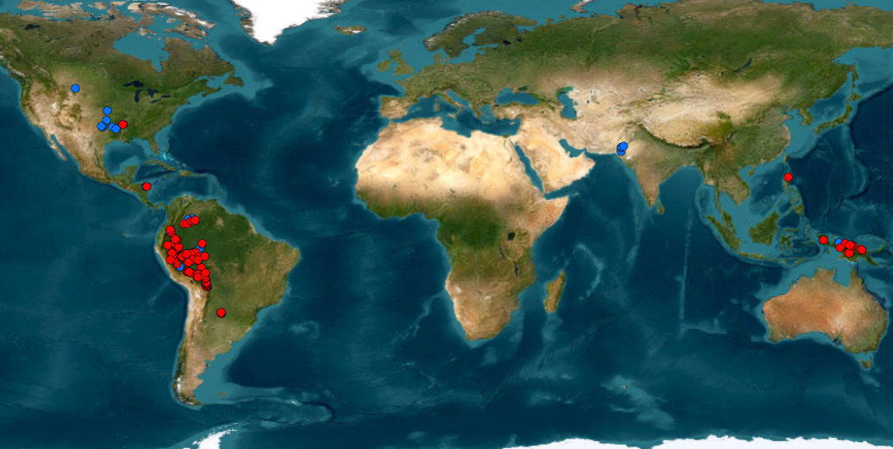
Dataset and Methodology
Tool: Google Earth Pro
we observe global oxbow lake’s creation and record the year that scroll bar occurred during this process by looking at the historical imageries in Google earth pro.
North America:
Chute: 10
Neck: 3
Tool: Google Earth Engine (Done by colleagues)
we also have the upstream, and downstream disconnection years of each oxbow lake, by having remote sensing images from GEE.
Southern Asia:
Chute: 4
South America:
Chute: 34
Neck: 135
Southeast Asia:
Chute: 12
Neck: 21
Make a comparison!
Does the scroll bar shows up before the disconnection? Or after it?
We again use Google Earth Pro to recheck all the cases that scroll bars form
before the upstream/.downstream disconnection.
Notes:
So, we built an one-dimensional model to understand how the bifurcation-confluence loop evolves. The model consists of two channels--the main channel (POINT) and the abandoned channel (POINT). We subdivide the main channel into the upstream, cutoff and downstream channels. In the model flow is simulated by Saint-venant equations, sediment transport is from the Engelund and Hansen formula, and bed adjustment is from the Exner equation. The benefit of this model is we can choose to simulate the neck or chute by changing Lc, when Lc is short, generally shorter than the channel width, we will have a neck cutoff(click). In opposite, we extend Lc, the model will be more look like a chute cutoff rather than a neck cutoff.

Slide 6
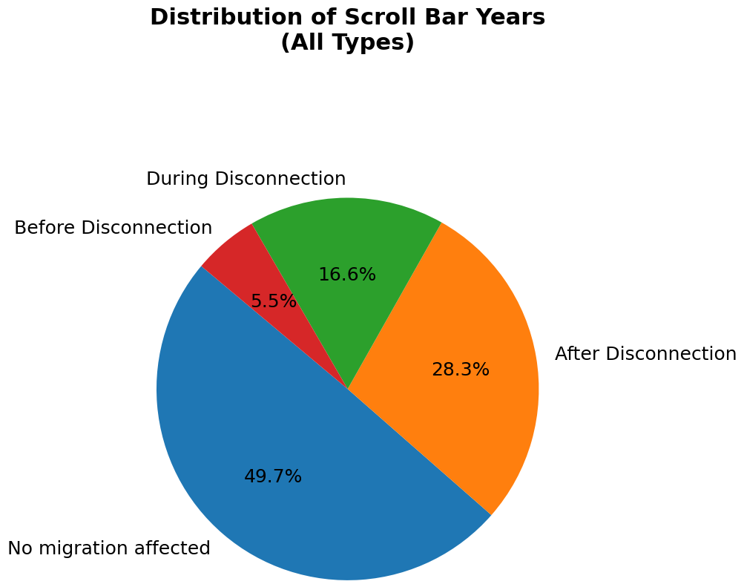
The majority of oxbow lakes are not formed with the existence of scroll bar.
No migration affected: no scroll bar formed at all.
Before disconnection: The scroll bar formed before the total closure of both the upstream and downstream limbs of the oxbow lake.
During disconnection: The scroll bar formed between the upstream and downstream closures.
After disconnection: The scroll bar formed after the plug bar formation.

Slide 7
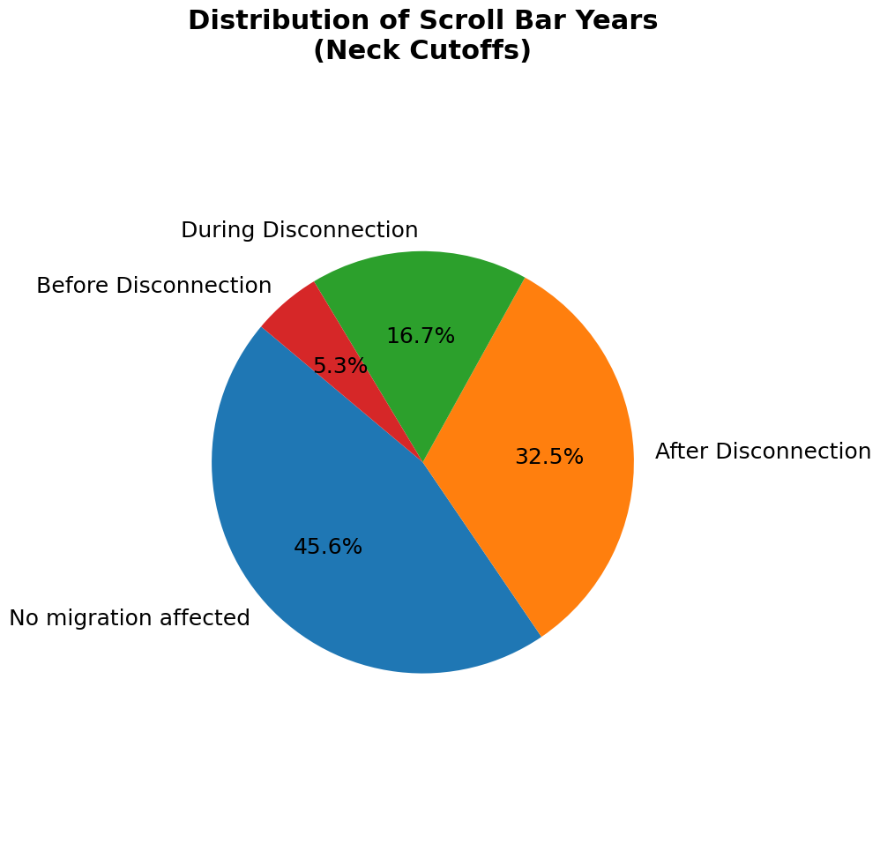
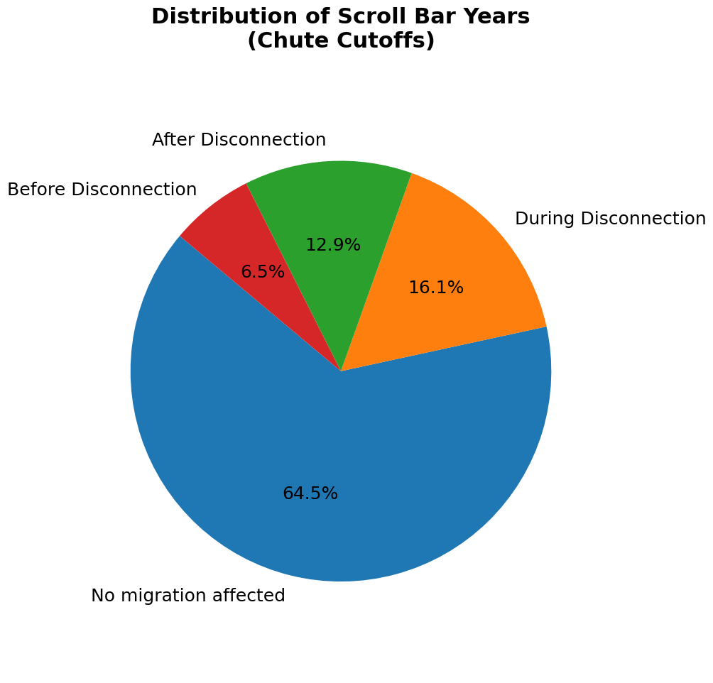
Neck cutoffs are affected by the migration more than chute cutoffs.

Slide 8
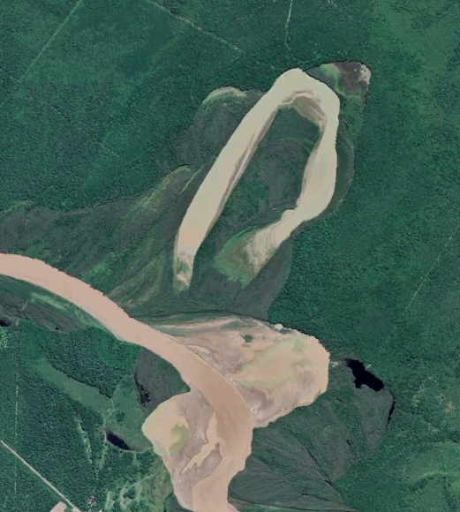
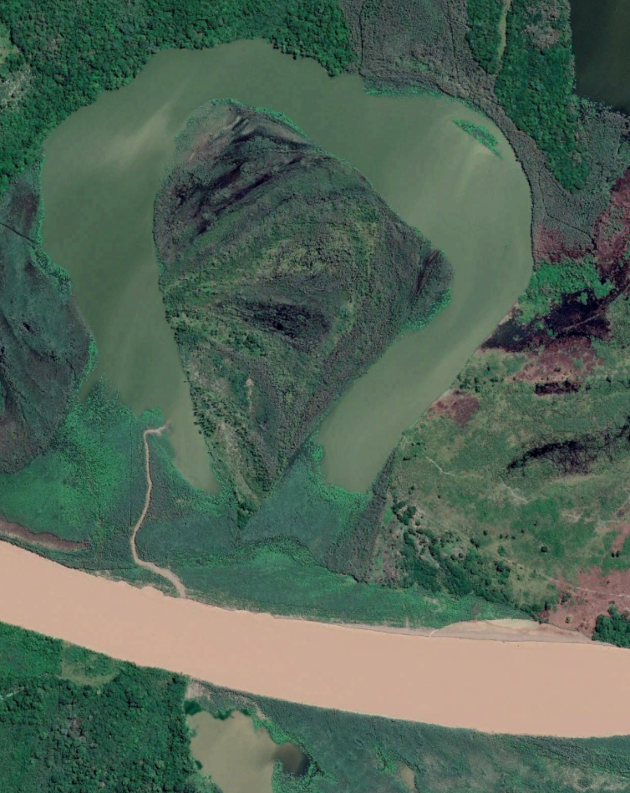
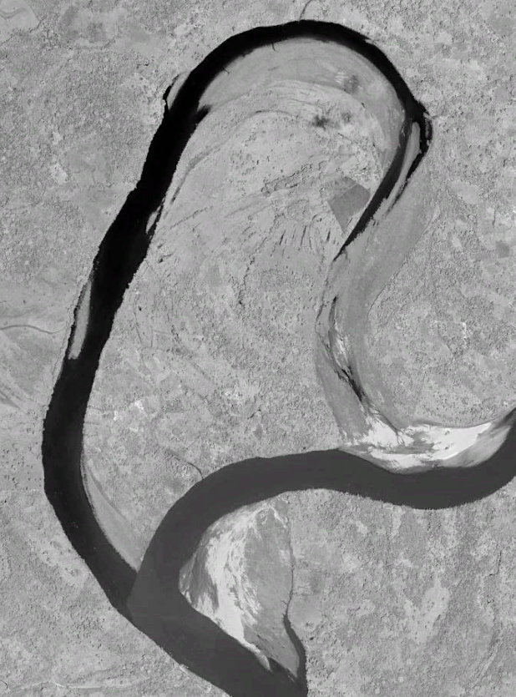
Case analysis(Scroll bar year = min (Up, down disc))
Case 48
Case 54
Case 378

Slide 9
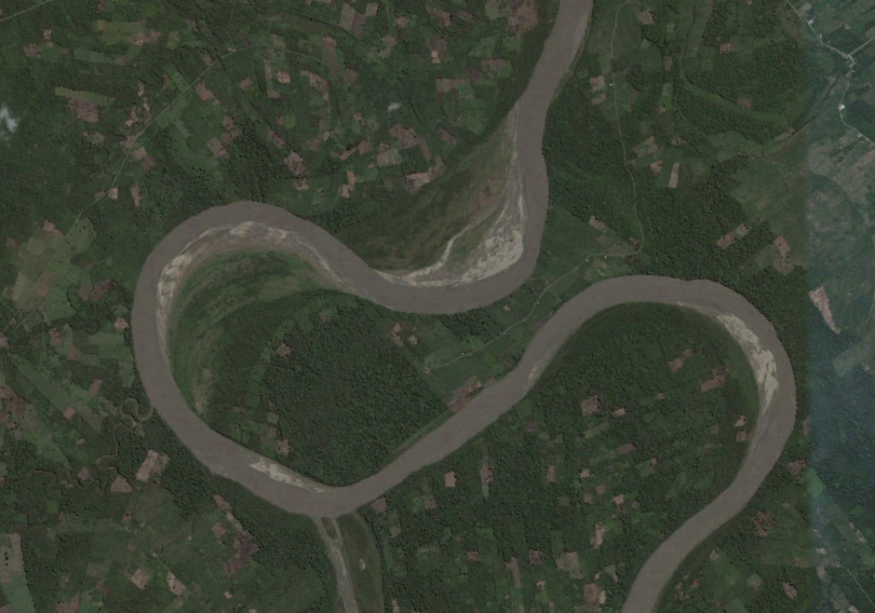
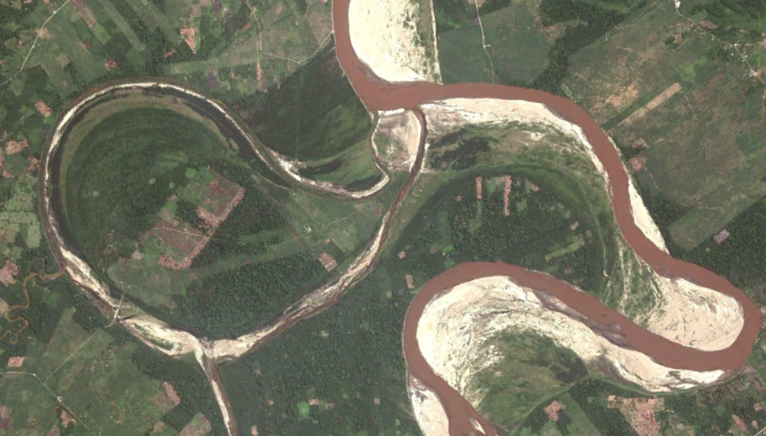
Case analysis(Scroll bar year < min (Up, down disc))
2006
Case 757
2010
In this case, migration enlarges the oxbow lake.
Tie channels are symbols of bifurcation dynamics which indicates that the oxbow lake is still active.

Slide 10
Conclusion and limitation
Conclusion:
The majority of oxbow lakes are formed mainly based on the bifurcation dynamics. Neck cutoffs are more likely to be affected by migration.
According to the tie channel feature, it is possible that migration changes the bifurcation hydraulic and sediment environment thus affects the morphology of oxbow lakes.
Limitation:
The approach is quite limited. Satellite imageries are not always available for all the cases every year.
The satellite image’s quality is a trouble to take over, especially for cases which occurred early.
Flooding/dry seasons may lead to error in estimation of scroll bar year.

